Slide 1
MACHINE LEARNING PROJECT
Telecom Customer Churn Prediction
Understanding churn patterns and estimating customer attrition
risk with Python
PRESENTATION BY :- PRADNYA HANDRALE
Dataset: IBM Telco Customer Churn | 7,043 customer records
PYTHON / PANDAS / SCIKIT-LEARN

Slide 2
EXECUTIVE SUMMARY
Project at a glance
7,043
21
26.54%
0.842
0.613
CUSTOMER RECORDS
ORIGINAL COLUMNS
OBSERVED CHURN
BEST ROC–AUC
BEST F1 SCORE
Business challenge
Analytical approach
Main takeaway
Customer churn affects recurring revenue. The project looks for customer patterns associated with leaving and builds a model to estimate churn likelihood.
Data checks → cleaning → EDA → statistical validation → feature engineering → model comparison → evaluation.
Logistic Regression achieved the strongest F1 and ROC–AUC in the model comparison, while Random Forest had higher accuracy.
PROJECT PRESENTATION • PYTHON • MACHINE LEARNING
02

Slide 3
BUSINESS CONTEXT
Why predict customer churn?
THE PROBLEM
PROJECT OBJECTIVES
When customers leave, a telecom provider can lose recurring revenue and the opportunity to build long-term relationships.
• Explore customer attributes and identify patterns linked with churn.
• Prepare data and engineer useful customer-level features.
• Train and compare classification models.
• Evaluate performance using more than accuracy.
• Translate model signals into retention questions for the business.
Intended use: support prioritisation and investigation — not automatic decisions about individual customers.
PROJECT PRESENTATION • PYTHON • MACHINE LEARNING
03

Slide 4
DATA UNDERSTANDING
Dataset & data preparation
7,043
21
0
0
11
ROWS
SOURCE COLUMNS
DUPLICATE ROWS
DUPLICATE IDs
CHARGE VALUES
Key data preparation steps
Target variable
• Converted TotalCharges to numeric; 11 blank/invalid entries became missing values.
• Checked for duplicate records, duplicate customer IDs and invalid negative values.
• Used a preprocessing pipeline for numeric imputation/scaling and categorical encoding.
• Excluded customerID from model inputs; retained Churn as the target.
Churn is encoded as a binary outcome: 0 = stayed, 1 = churned. The task is customer-level binary classification.
PROJECT PRESENTATION • PYTHON • MACHINE LEARNING
04

Slide 5
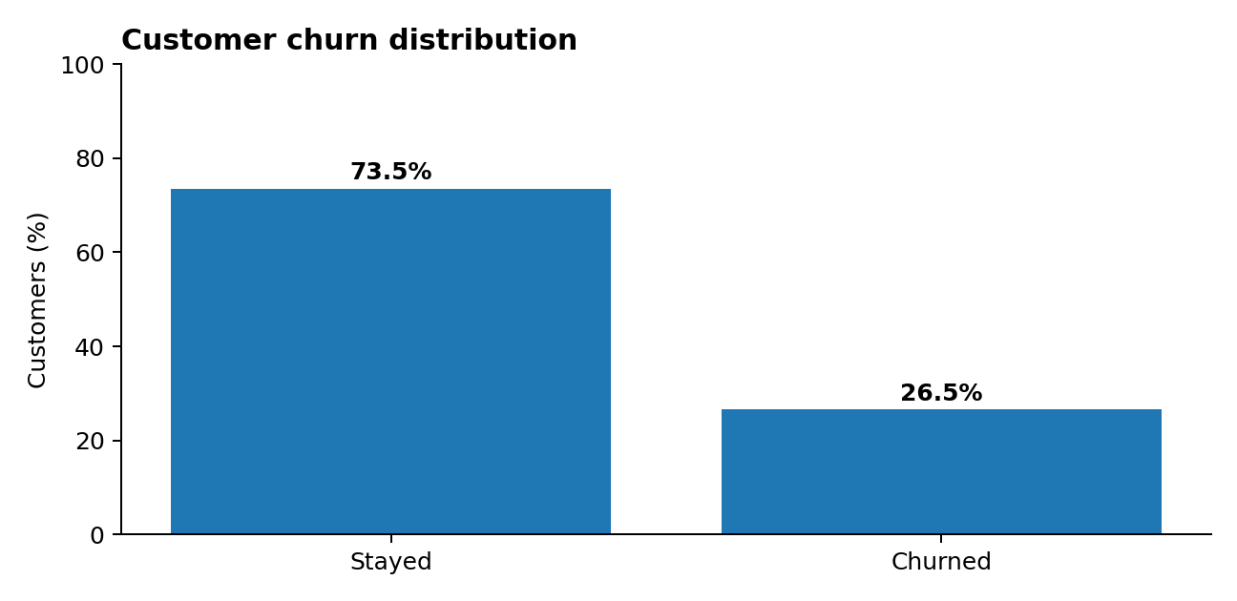
EXPLORATORY ANALYSIS
Churn profile in the dataset
5,174
1,869
STAYED
CHURNED
What this means
The dataset is imbalanced: roughly three in four customers stayed, while about one in four churned. Accuracy alone can hide weak churn detection.
Observed churn rate: 26.54%
PROJECT PRESENTATION • PYTHON • MACHINE LEARNING
05

Slide 6
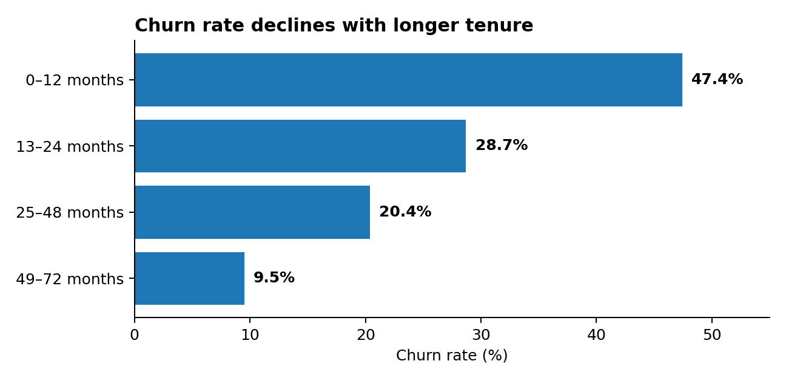
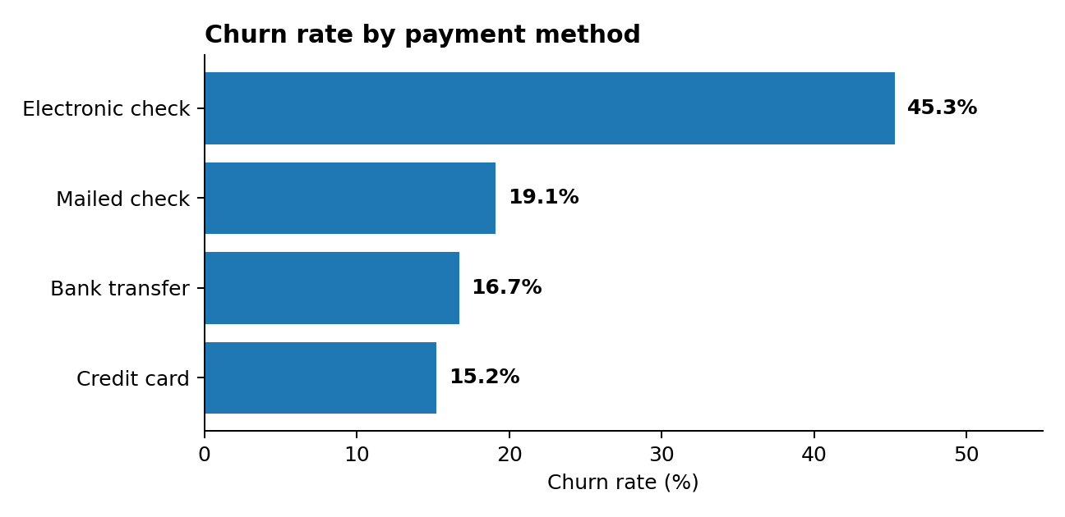
EXPLORATORY ANALYSIS
Patterns that stand out
Churn is highest among customers with shorter tenure and among customers paying by electronic check.
PROJECT PRESENTATION • PYTHON • MACHINE LEARNING
06

Slide 7
EVIDENCE BEYOND VISUAL PATTERNS
Statistical validation
CHI-SQUARE TEST: CONTRACT TYPE × CHURN
Interpretation
1,184.60
2
5.86 × 10⁻²⁵⁸
The very small p-value indicates a statistically significant association between contract type and churn in this dataset.
CHI-SQUARE
DEGREES OF FREEDOM
P-VALUE
Important distinction
An association does not establish that contract type causes churn. Results should be interpreted alongside customer context and business knowledge.
PROJECT PRESENTATION • PYTHON • MACHINE LEARNING
07

Slide 8
MACHINE LEARNING
Model development workflow
01
02
03
04
05
Split
→
Preprocess
→
Train
→
Evaluate
→
Validate
80% train
20% test
Impute, scale
& encode
Logistic Regression
& Random Forest
Precision, recall,
F1 & ROC–AUC
5-fold stratified
cross-validation
The target was stratified during the split; the test set contains 1,409 records.
PROJECT PRESENTATION • PYTHON • MACHINE LEARNING
08

Slide 9
EVALUATION ON THE HELD-OUT TEST SET
Model comparison
Model | Accuracy | Precision | Recall | F1-score | ROC–AUC
Logistic Regression | 0.734 | 0.499 | 0.794 | 0.613 | 0.842
Random Forest | 0.764 | 0.547 | 0.636 | 0.588 | 0.822
Best F1 & ROC–AUC: Logistic Regression
Highest accuracy: Random Forest
F1 = 0.613 | ROC–AUC = 0.842
Higher churn recall: 0.794
Accuracy = 0.764
F1 = 0.588 | ROC–AUC = 0.822
Selection depends on the business objective. For identifying more churners, Logistic Regression's higher recall is important.
PROJECT PRESENTATION • PYTHON • MACHINE LEARNING
09

Slide 10
VALIDATION
Reliability checks
RANDOM FOREST · 5-FOLD STRATIFIED CROSS-VALIDATION
ACCURACY
PRECISION
RECALL
Baseline classifier
0.779 ± 0.013
0.574 ± 0.022
0.643 ± 0.034
Most-frequent baseline: 0.735 accuracy, but 0.000 churn recall. It predicts the majority class and fails to identify churners.
F1
ROC-AUC
0.607 ± 0.027
0.829 ± 0.010
Why it matters
Cross-validation checks performance across multiple stratified folds rather than relying on one split.
Cross-validation figures shown are from the notebook's Random Forest pipeline.
PROJECT PRESENTATION • PYTHON • MACHINE LEARNING
10

Slide 11
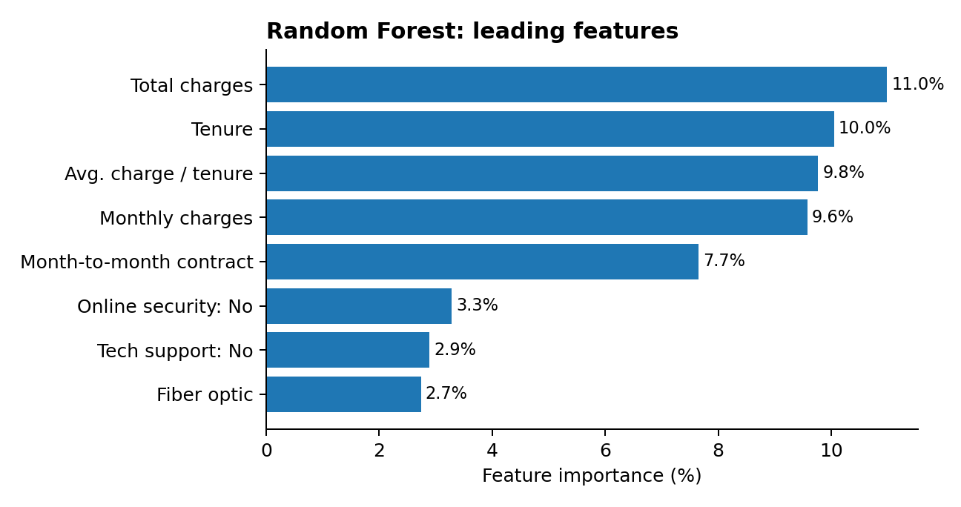
MODEL INTERPRETABILITY
What influences the Random Forest?
Top signals
Total charges, tenure, average charge per tenure month, monthly charges and month-to-month contract ranked highest.
Use with care
Feature importance indicates how the fitted model uses variables; it does not prove causal effects or explain an individual prediction.
PROJECT PRESENTATION • PYTHON • MACHINE LEARNING
11

Slide 12
RESPONSIBLE INTERPRETATION
Limitations & next steps
Dataset limitations
Model limitations
Public sample may not represent every provider. It is a customer snapshot, not a complete dated event history. Observed associations do not prove causation.
Performance is moderate and depends on the chosen metric. A single sample prediction is not evidence of general model quality.
Recommended next steps
• Validate on recent, provider-specific customer data.
• Add dated customer history to support time-based validation.
• Tune thresholds using retention-team capacity and the cost of missed churners.
• Run controlled retention experiments before attributing business impact.
PROJECT PRESENTATION • PYTHON • MACHINE LEARNING
12

Slide 13
CONCLUSION
From churn patterns
to actionable insight
This project combines data preparation, exploratory analysis, statistical testing and machine learning to study customer churn.
KEY TAKEAWAYS
• 26.54% of customers in the sample churned.
• Shorter tenure and electronic-check payment show higher observed churn rates.
• Logistic Regression led on F1 and ROC–AUC in the comparison.

